Slide 1
FitBit Fitness Tracker Data Analysis
Shaiza Mann

Slide 2
TABLE OF CONTENTS
01
04
02
05
03
06
Ask
Analyse
Business Task,
Key Stakeholders
Exploratory Data Analysis,
Hypothesis Testing
Prepare
Share
Dataset selection,
Data integrity verification
Presenting findings to stakeholder
Process
Act
Data Cleaning,
Sifting
Recommendations, Plausible solutions

Slide 3
INTRODUCTION
The Fitbit Fitness Tracker Data Analysis Project is an exploration of the vast amounts of data collected by Fitbit's popular fitness tracking devices from 33 individuals. This project aims to uncover insights and trends that can be used to improve individual health and wellness outcomes, as well as inform broader public health initiatives.

Slide 4
01
Ask

Slide 5

BUSINESS TASK
To use the Fitbit Fitness Tracker Data to analyze trends in users’ daily habits and provide insights to help guide marketing strategy for Healthcare companies.
What are some trends in smart device usage?
How could these trends apply to health conscious customers?
How could these trends help influence healthcare companies’ marketing strategies?

Slide 6
DIRECTIONS
Project
Fitbit smartwatch: health and fitness tracking with heart rate, sleep, and workout monitoring.
Analysis
Analysis that guides marketing strategy and help unlock new growth opportunities.
Impact
Analyzing Fitbit data can improve health by informing personalized plans based on physical activity, sleep, and wellness patterns.

Slide 7
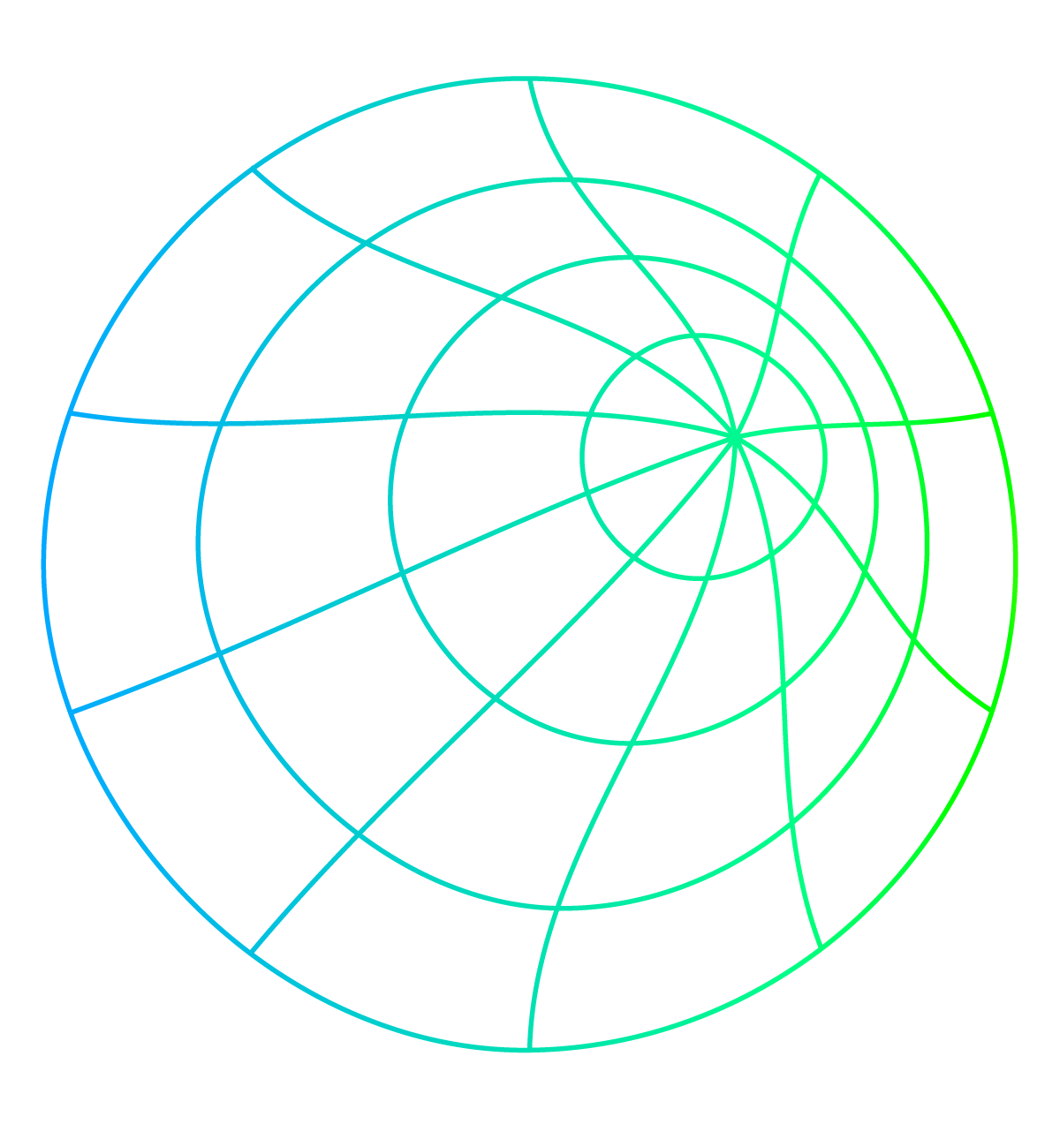
DATA PROJECT WORKFLOW
Dataframes Selection
EDA
Insights
Hypothesis Testing
Results
Interpretation
Presentation

Slide 8
02
Prepare

Slide 9
DATA ORIGIN
These datasets were generated by respondents to a distributed survey via Amazon Mechanical Turk between 03.12.2016-05.12.2016. Thirty eligible Fitbit users consented to the submission of personal tracker data, including minute-level output for physical activity, heart rate, and sleep monitoring.
Link: https://www.kaggle.com/datasets/arashnic/fitbit
Data Provenance:

Slide 10
DATA DICTIONARY
Data Header | Data Type | Data Description
df_daily | dataframe | Daily activity monitoring
df_sleepDay | dataframe | Sleep monitoring
df_weight | dataframe | Weight monitoring
total_active_min | integer | Sum of active+light_active+sedentary minutes
calories | integer | Calories burned
total_minutes_asleep | integer | Account of total minutes asleep

Slide 11
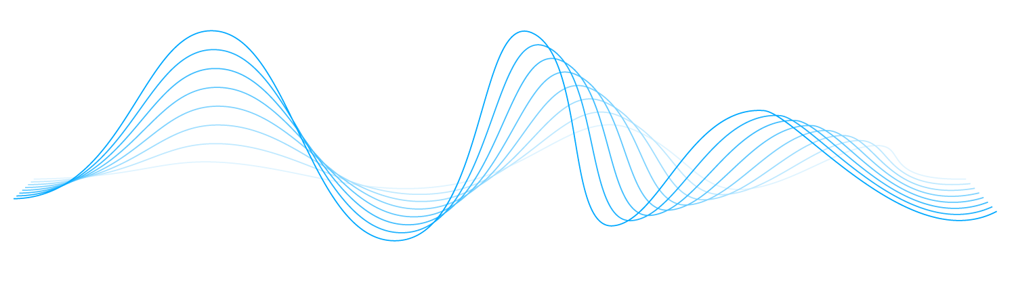
Process
03

Slide 12
CLEANING PROCESS
Changed the mismatched data types.
Changed the dates format consistently throughout the dataset.
Renamed the columns in a meaningful, user friendly way
Merged dataframes to remove redundancy

Slide 13
04
Analyse

Slide 14
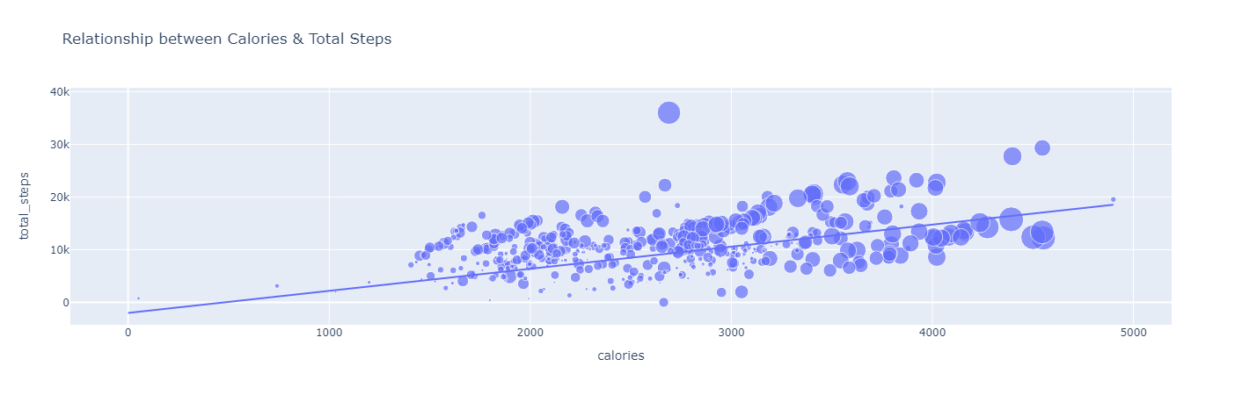
EDA: CALORIES Vs. TOTAL STEPS

Slide 15
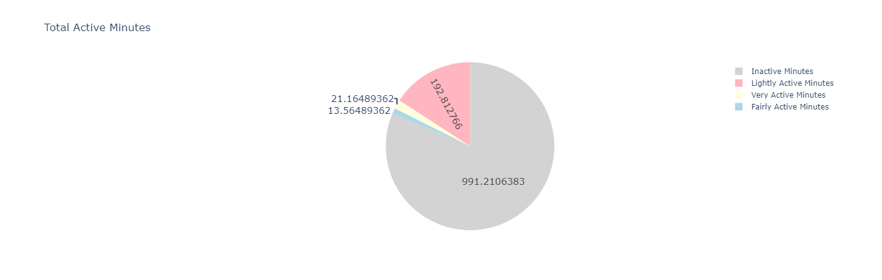
EDA: TOTAL ACTIVE MINUTES

Slide 16
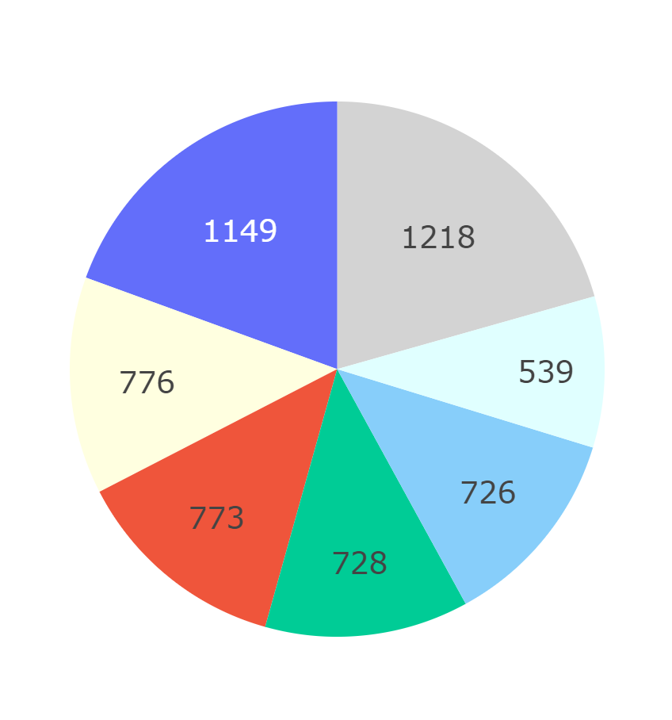
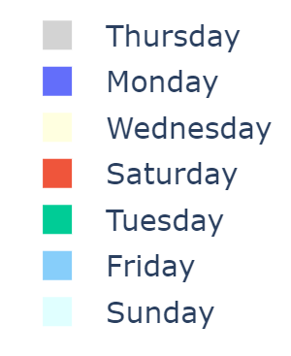
EDA: INACTIVE MINUTES DAILY

Slide 17
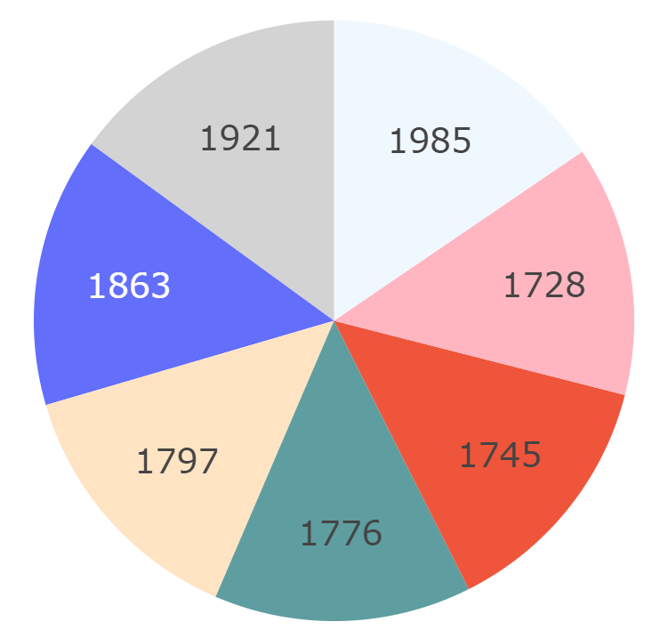
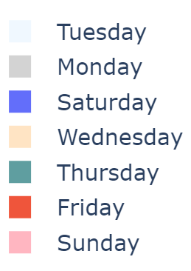
EDA: CALORIES BURNED DAILY

Slide 18
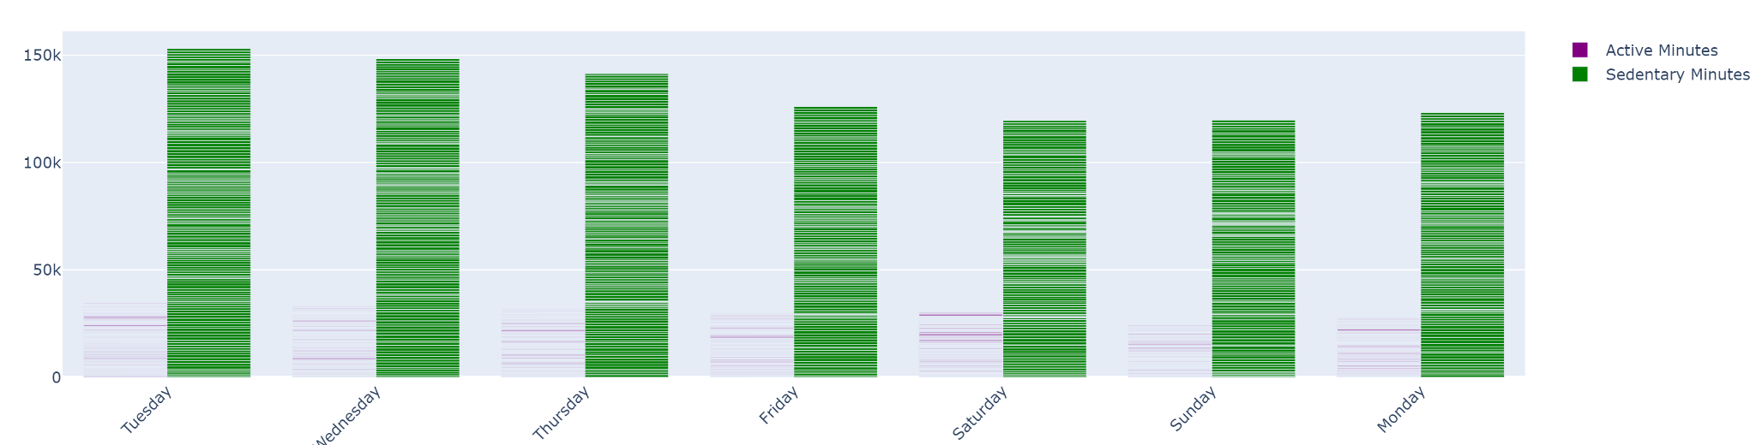
EDA: TOTAL ACTIVE vs. INACTIVE MINUTES

Slide 19
Hypothesis’ Testing
H_{O}: THERE IS NO SIGNIFICANT RELATIONSHIP BETWEEN HOW MUCH TIME A PERSON SPENDS BEING ACTIVE AND THE NUMBER OF CALORIES THEY BURN. | Correlation coefficient between TotalActiveTime and Calories: 0.3941880254498795 Calculated t-value: 8.695503562165063 Critical t-value: 1.9657526798608886 Null Hypothesis is rejected. Alternate Hypothesis is accepted, i.e. there is a positive relationship between the TotalActiveTime and Calories burnt.
H_{O}: THERE IS NO SIGNIFICANT RELATIONSHIP BETWEEN HOW MUCH TIME A PERSON SPENDS BEING ACTIVE AND THE LENGTH OF SLEEP. | Correlation coefficient between TotalActiveTime and TotalMinutesAsleep: -0.06376059520667852 Calculated t-value: -1.2952627206903726 Critical t-value: 1.9657526798608886 Null Hypothesis is accepted. Alternate Hypothesis is rejected, i.e. there is no significant relationship between the TotalActiveTime and TotalMinutesAsleep.

Slide 20
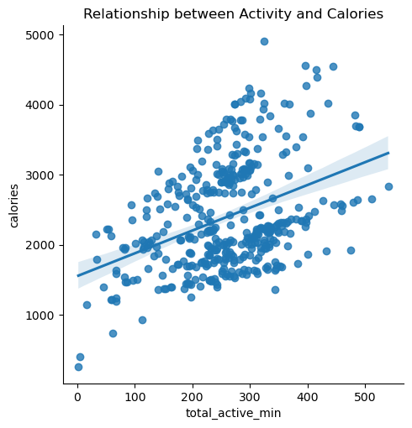
H_{o}: Total Active Time Vs. Calories

Slide 21
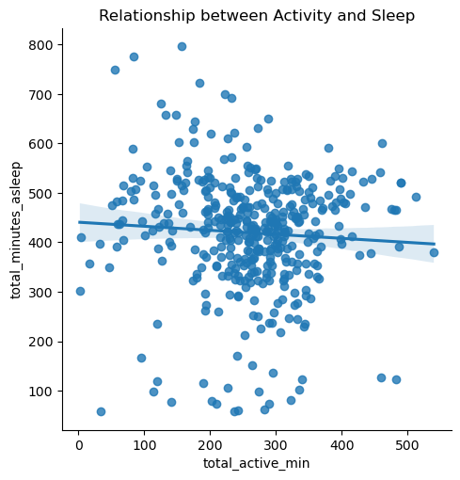
H_{o}: Total Active Time Vs. Length of Sleep

Slide 22
STEPS TO TEST HYPOTHESIS
To test a hypothesis using the critical value of t,
Calculate the t value for your sample using this formula: t = r * sqrt(df / (1 - r²)).
Find the critical value of t in the t table.
Determine if the (absolute) t value is greater than the critical value of t.
Reject the null hypothesis if the sample’s t value is greater than the critical value of t. Otherwise, accept the null hypothesis.

Slide 23
05
Share

Slide 24
FINDINGS
From all the 33 Fitbit users in the sample only 25 have sleep records. The reason could be lack of comfort to wear it during sleep. On average users who recorded their sleep, are getting the recommended amount of sleep 6-9 h per day.
Throughout the day one Fitbit user would spend 80% of the time being sedentary and 20% of the time doing various types of physical activity. This indicates that Fitbit is not only used as sportswear accessory but also casually during the day.
According to the steps index, the most active days are Wednesday, Saturday and Sunday. The “active” graduation corresponds to a number of steps between 10,000 and 12,499 steps per day.

Slide 25
Act
06

Slide 26
What are some trends in smart device usage?
Positive relationship between both Calories Burned and Total Steps and Total Active Time.
There is no conclusive relationship between quality of sleeps and intensity of activity in the day
User tends to be more active on weekend (Saturday)

Slide 27
How could these trends help influence healthcare companies’ marketing strategies?
The trends could be useful for these companies to retain users who want to improve their lifestyles or simply monitor their daily activity by reminding them to have an active lifestyle.
Recommendations:
Recommending activities or motivating messages that can improve active minutes.
Reminder on weekdays to exercise when users are least active
Reminder to have enough rest / sleep when users are most active (e.g., on a Saturday)

Slide 28

THANKS
Do you have any questions?
workplace.shaiza@gmail.com

